Slide 1
SPOT
IN THE SHADOW
Arago Spot

Slide 2


Submitted To
Submitted By
Dr. Yogita Kalra
Department of Applied Physics
YASH GUPTA
PULKIT PANDEY
2K19/EP/105
2K19/EP/076

Slide 3
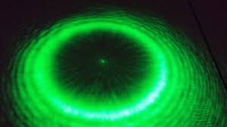
INTRODUCTION TO POISSON’S SPOT
In optics, the Arago spot, Poisson’s spot also known as Fresnel spot is a bright point that appears at the center of a circular object's shadow.
The first -time observation of Poisson’s (or Arago’s) spot in 1818 constituted one of the most relevant experiments in the history of optics, helping discard the (at the time) favoured position of attributing a corpuscular nature to light.
This spot played an important role in the discovery of the wave nature of light and is a common way to demonstrate that light behaves as a wave.
Spot in the shadow

Slide 4
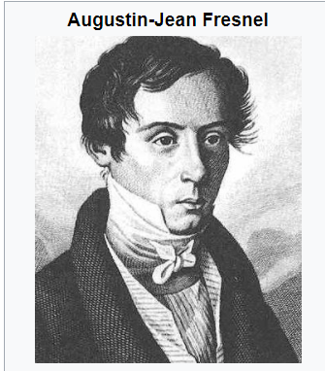
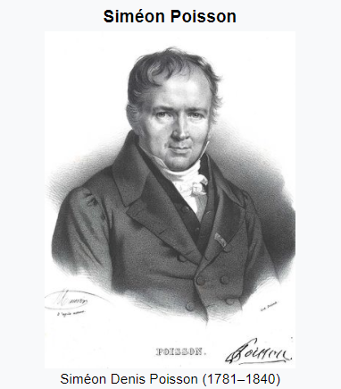
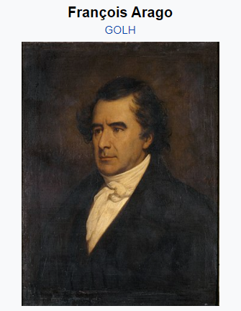
Tale From The Past.

Slide 5
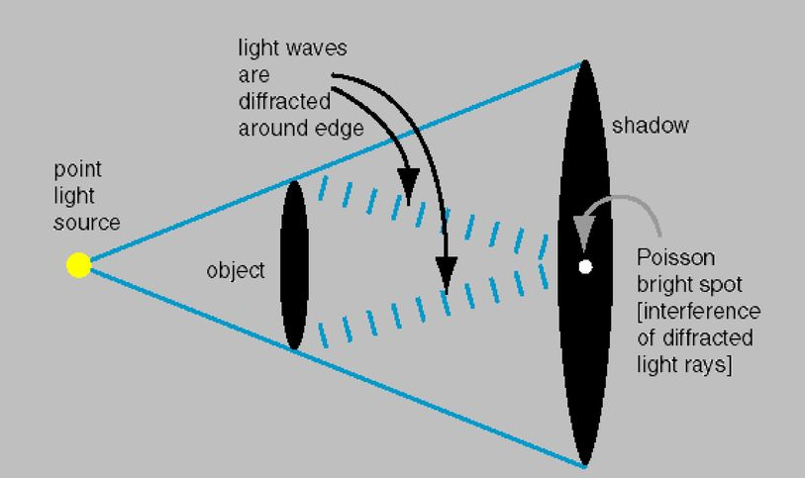
Fundamentals Of Arago Spot
This phenomenon cannot be explained by geometric optics, in which the obstacle is opaque.
Light penetrates behind the object because of diffraction of light waves.
The spot at the center is the consequence of the constructive interference of light waves diffracted on the edge of the disk, its central position being determined by the symmetry of the disk.
The Poisson spot is further evidence for the validity of wave optics.

Slide 6
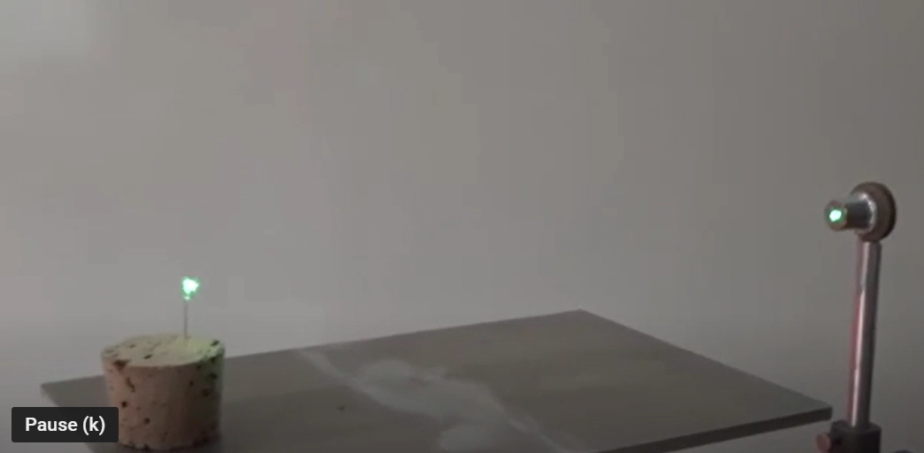

Slide 7
Lateral Intensity of Poisson’s Spot
ANALYTICAL METHOD

Slide 8

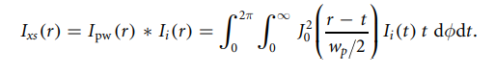
Lateral intensity distribution of Poisson’s spot from a source of plane waves (point source at infinite distance) in the Fresnel regime, which can be expressed in terms of a zero-order Bessel function of the first kind J0
The final lateral intensity distribution of poisson’s spot is ]given by convolution of bessel function and delta function as point spread function . Lateral Intensity due to spatial coherence is:

Slide 9
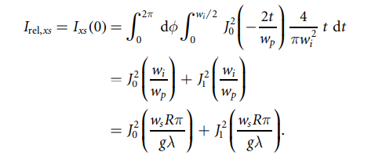
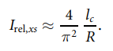
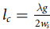
Let’s analyze the peak intensity at r = 0. Solving the integral convulsion, relative intensity is follows:
where

Slide 10
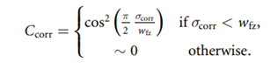
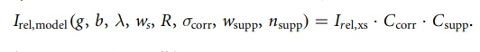
The final Model equation results in
Variation in Intensity due to edge corrugation of disc.
The corrugation factor:

Slide 11
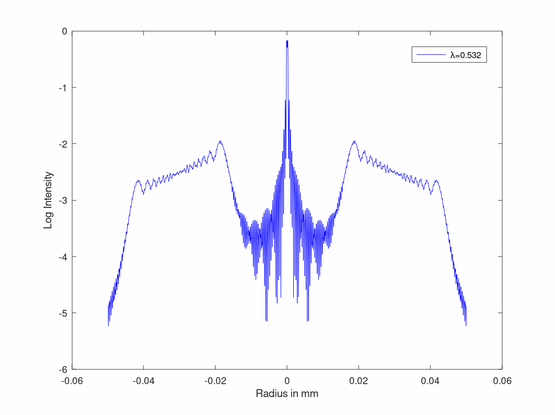
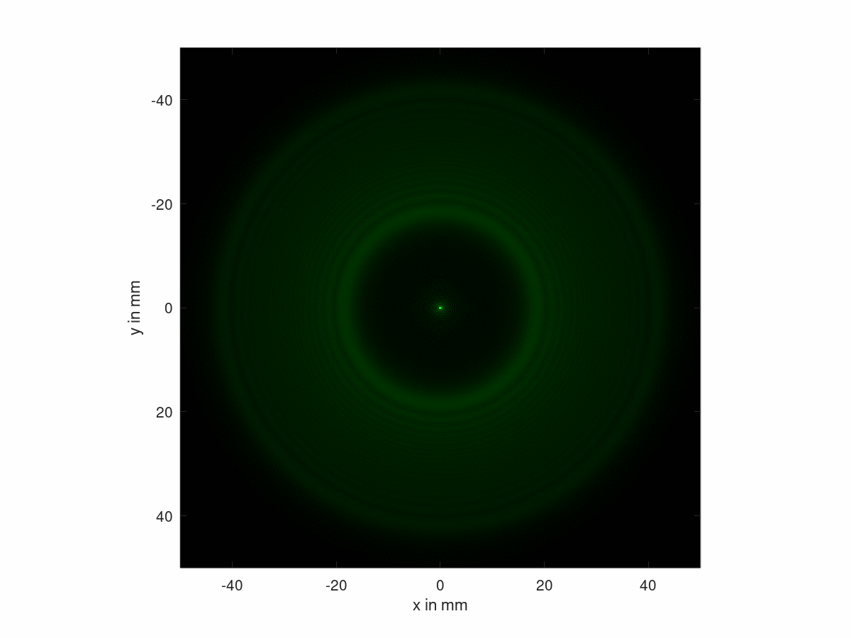
Simulation
The interference pattern produced by light diffracted through a small disk in a plane perpendicular to the propagation direction of the light waves.
You can adjust the wavelength of the light and set the observed domain to examine details of the interference pattern.

Slide 12
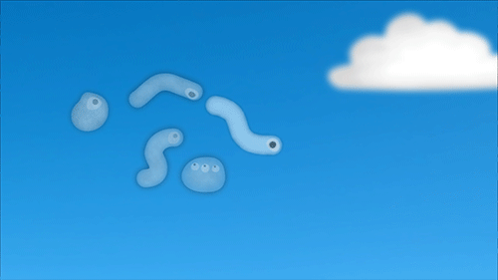
SO WHAT IS THE SIGNIFICANCE OF POISSON SPOT IN TODAY’S WORLD??
FLOATERS
Little particles actually drifting around inside your eyeball.
And they can be all sorts of different shapes, but some of them are spheres.
And so they cast a shadow on the back of your retina.
And right in the middle of that shadow is Poisson's bright spot.

Slide 13
SO WHAT IS THE SIGNIFICANCE OF POISSON SPOT IN TODAY’S WORLD??
Understanding of this phenomenon helps in the study of the wave-particle duality for objects of increasing size and the measurement of particle–surface interaction potentials,
The Poisson spot has been used in lithography to fabricate microtube arrays for which its shaping via incomplete spiral phase modulation has interesting prospects.
Kouznetsov and Lara proposed the use of the distance at which the Poisson spot vanishes behind the obstacle as a measure for its surface corrugation and shape of balls, as used for example in ball-bearings
The Poisson spot has been used in lithography to fabricate microtube arrays for which its shaping via incomplete spiral phase modulation has interesting prospects.

Slide 14
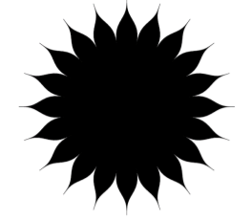
SO WHAT IS THE SIGNIFICANCE OF POISSON SPOT IN TODAY’S WORLD??
The extinction of Poisson’s spot is also of relevance in the search for extra-solar planets, where a petal-shaped star shade has been proposed as part of an external coronagraph aiming at their detection and spectroscopic characterization
YOUR LOGO

Slide 15
THANK YOU!!

